Slide 1
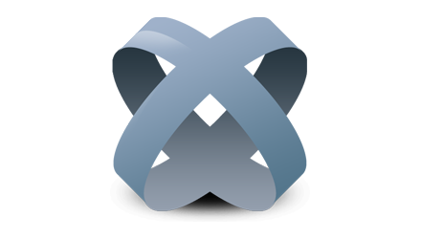
TITANIUM
CA Mobile App Development
T00165634

Slide 2
The Frameworks Role
Appcelerator Titanium is one such framework that supports for standard-based web technologies like CSS3, HTML5, JavaScript, Python, Ruby, PHP and more.
This platform also provides a platform-independent API to access native UI components such as menus, alerts, navigation bars, dialog, boxes and native device functionality such as network, sound, file system and more.
Integrated support for various popular JavaScript and Ajax Frameworks such as MooTools, jQuery, YUI, Scriptaculous and others.

Slide 3
It is one such wonderful framework that allows you to develop all types of applications for your mobile like business, entertaining, education, finance, health-care and more.
There are lots of enterprises that require native functionality with mobile phones and Appcelerator Titanium allows for full access to the mobile devices’ camera.

Slide 4
FEATURES
Development framework facilitates component reuse for app factory approach
Emulator and on-device debugging ensures high quality apps
Integrated with Titanium Cloud Services for buildingcloud-connected apps
One-click mobile app deployment
Advanced Code Assist

Slide 5
LIMITATIONS
Increasing complexity. The development complexities rise more than proportionally to application complexity increases. The more complex your applications become, the more often you’ll have to deal with, on the one hand technical issues on the other hand a greater effort (code organization, MVC separation, multi-device support, multi-platform support, code readability, etc.).
No Freemium. Too unstable for production use. Having to renounce the freemium pricing model is not just a minor inconvenience since 72% of total App Store revenue comes from apps featuring in-app purchases.

Slide 6
Flexibility limitations. At beginning you’ll love the well-defined Titanium API. But sooner or later you will face strange bugs and limitations. For example, if you want to apply a cell background gradient to a grouped table you get that the grouped table becomes plain and the gradient color makes the table slow when scrolling, and you will have to use images.So at first you will save a lot of time but as more complex the project grows you’ll lose the saved time in fixing and workarounds.
Laggy. Keep in mind that a Titanium application is the result of an automatic conversion process from web code to native code. Animations are noticeably laggy and apps are not responsive when return from the background. This is particularly evident with Android devices, less evident with iOS devices (especially those with A5 processor).

Slide 7






APPS THAT USE
TITANIUM

Slide 8
OTHER FRAMEWORKS
Apache Flex
ChocolateChip-UI
eMobc
Dojo Mobile
JQuery Mobile
Kendo UI
Marmalade

Slide 9
WHY?
Titanium is an open-source framework that allows the creation of mobile apps onplatforms including iOS,Android, Windows Phone, BlackBerry OS, and Tizen from a single JavaScript codebase. In February 2013,Business Insider estimated that 10% of all smartphones worldwide ran Titanium-built apps. As of 2013, Titanium had amassed nearly 500,000 developer registrations.

